Slide 1
LSTM Networks
Deep Learning
Notes:
Introduction to the presentation on LSTM Networks.

Slide 2

Introduction
LSTM stands for Long Short-Term Memory
Type of Recurrent Neural Network (RNN)
Used for sequential data processing
Effective in handling vanishing gradients
Key component in many deep learning models
LSTM networks have feedback connections
Allowing information to flow in a loop
Enabling the network to keep track of state
Over time, making predictions more accurate
Notes:
Introduce the concept of LSTM networks, explaining their role in deep learning and their ability to handle sequential data. Provide examples of applications where LSTMs are commonly used, such as natural language processing and speech recognition. Ask students to consider the challenges of working with sequential data and how LSTMs can help address these challenges.

Slide 3
Motivation for LSTMs
Traditional RNNs suffer from vanishing gradients
Making it difficult to learn long-term dependencies
LSTMs introduce memory cells to store information
Enabling the network to learn complex patterns
Gates control the flow of information in and out
Of the memory cells, allowing for selective forgetting
LSTMs can handle sequential data with varying lengths
And can be used for both classification and regression tasks
LSTMs are particularly useful for time-series forecasting
Notes:
Explain the motivation behind the development of LSTMs, highlighting the limitations of traditional RNNs and how LSTMs address these limitations. Discuss the role of memory cells and gates in LSTMs, and provide examples of how LSTMs can be applied to real-world problems. Ask students to think about how LSTMs can be used to improve the performance of traditional RNNs.

Slide 4
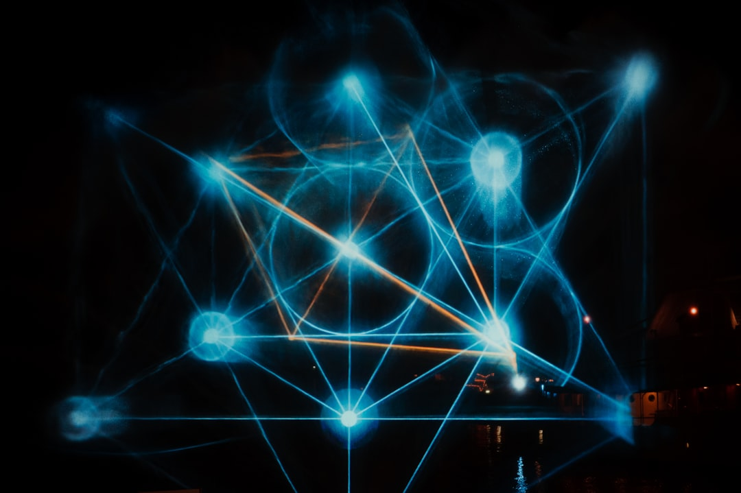
LSTM Architecture
LSTM uses memory cells to store long-term information across time steps
Each cell has input, forget and output gates controlling information flow
Cell state acts as a conveyor belt preserving important signals over long sequences
Gates use sigmoid activations to decide what to keep, update or discard
Hidden state exposes filtered information to the next layer or time step
Notes:
Explain the architecture of LSTMs, highlighting the different components and how they interact. Use the user-provided content to guide the discussion, and provide examples to illustrate the key concepts. Ask students to consider how the architecture of LSTMs enables them to learn complex patterns in sequential data.

Slide 5
Gates in LSTM
Input gate controls the flow of new information
Output gate controls the flow of information out
Forget gate controls what to forget from previous steps
Gates are used to regulate the memory cells
Enabling the network to learn what to remember
And what to forget, allowing for selective memory
Gates are implemented using sigmoid and tanh functions
Allowing for non-linear interactions between gates
Gates play a crucial role in the performance of LSTMs
Notes:
Explain the role of gates in LSTMs, discussing how they control the flow of information in and out of the memory cells. Provide examples of how the gates are used to regulate the memory cells, and discuss the importance of gates in the performance of LSTMs. Ask students to consider how the gates enable LSTMs to learn complex patterns in sequential data.

Slide 6
Training Details
LSTMs are trained using backpropagation through time
Involves unrolling the network in time
And computing the gradients of the loss function
LSTMs can be trained using various optimization algorithms
Such as stochastic gradient descent and Adam
Regularization techniques can be used to prevent overfitting
Such as dropout and weight decay
LSTMs can be trained on large datasets
And can be used for both supervised and unsupervised learning
Notes:
Discuss the details of training LSTMs, explaining the process of backpropagation through time and the importance of regularization techniques. Provide examples of optimization algorithms and regularization techniques that can be used to train LSTMs, and discuss the importance of training LSTMs on large datasets. Ask students to consider the challenges of training LSTMs and how to address these challenges.

Slide 7
Applications
Natural language processing and speech recognition
Time-series forecasting and prediction
Sentiment analysis and text classification
Machine translation and language modeling
Speech synthesis and music generation
LSTMs can be used for both classification and regression tasks
LSTMs can be used for both supervised and unsupervised learning
LSTMs have many real-world applications
And are widely used in industry and academia
Notes:
Explain the various applications of LSTMs, highlighting their use in natural language processing, speech recognition, and time-series forecasting. Provide examples of how LSTMs can be used for both classification and regression tasks, and discuss the importance of LSTMs in both supervised and unsupervised learning. Ask students to think about how LSTMs can be applied to real-world problems and the potential benefits of using LSTMs in these applications.

Slide 8
Summary
LSTMs are a type of RNN
Used for sequential data processing
LSTMs have memory cells and gates
Enabling the network to learn complex patterns
LSTMs can be used for both classification and regression tasks
LSTMs have many real-world applications
LSTMs are widely used in industry and academia
LSTMs are a powerful tool for deep learning
And can be used to improve the performance of traditional RNNs
Notes:
Summarize the key takeaways from the presentation, highlighting the importance of LSTMs in deep learning and their ability to handle sequential data. Emphasize the key components of LSTMs, including memory cells and gates, and discuss the various applications of LSTMs. Ask students to reflect on what they have learned and how they can apply LSTMs to real-world problems. Provide final thoughts and encourage students to explore LSTMs further.

